Slide 1


Student Performance & Attendance Analyzer
SUBMITTED BY
SUPERVISION & DEPARTMENT
INSTITUTION
Annesha Chowdhury
Dept. of Computational Sciences
Brainware University
Roll No: 26102410002
Supervisor: Mr. Rahul Kumar Ghosh
Master of Computer Applications
Code: BWU/MCA/26/003
Academic Session 2026

Slide 2



CHAPTER 1
Introduction & Overview
Academic Context
Automated Analytics
Actionable Insights
Educational institutions process massive volumes of marks and attendance records every semester, leading to severe administrative overhead.
A lightweight Python CLI tool built to process CSV dataset inputs, compute metrics, and generate clear graphical statistics automatically.
Enables quick identification of low-attendance defaulters and academic failure risks through visual chart reports.

Slide 3
CHAPTER 2
Problem Statement
Manual Overhead
Delayed Interventions
Lack of Visual Insights
Manual register management is repetitive, labor-intensive, and prone to calculation errors.
Teachers struggle to identify at-risk students before final term examinations arrive.
Spreadsheet data fails to present visual distributions for quick academic evaluation.

Slide 4
CHAPTER 3
Project Objectives
Automate CSV Data Loading & Validation: Seamless parsing of academic records.
Compute Core Metrics: Calculate total marks, percentage, attendance %, and grades.
Identify Low Attendance Defaulters: Filter students falling below 75% cutoff threshold.
Generate Visual Reports: Export automated Matplotlib bar, line, and histogram charts.

Slide 5
CHAPTER 4
Scope of the Project
Target Audience
Project Boundaries
Class Teachers: Quick performance tracking.
Data Source: CSV file input processing.
Academic Heads: Departmental summaries.
Interface: Command-line CLI menu system.
Students: Python data analysis reference.
Output: Saved visual charts & console text.

Slide 6
CHAPTER 5
Existing System vs. Proposed Solution
Traditional Method
Proposed System
Manual Register / Excel Sheets:
Automated Python Analyzer:
Requires manual formula creation, static chart setup, and time-consuming data filtering for every class section.
Instant CSV parsing, single-click leaderboard sorting, automatic cutoff alerts, and standard visual report exports.

Slide 7




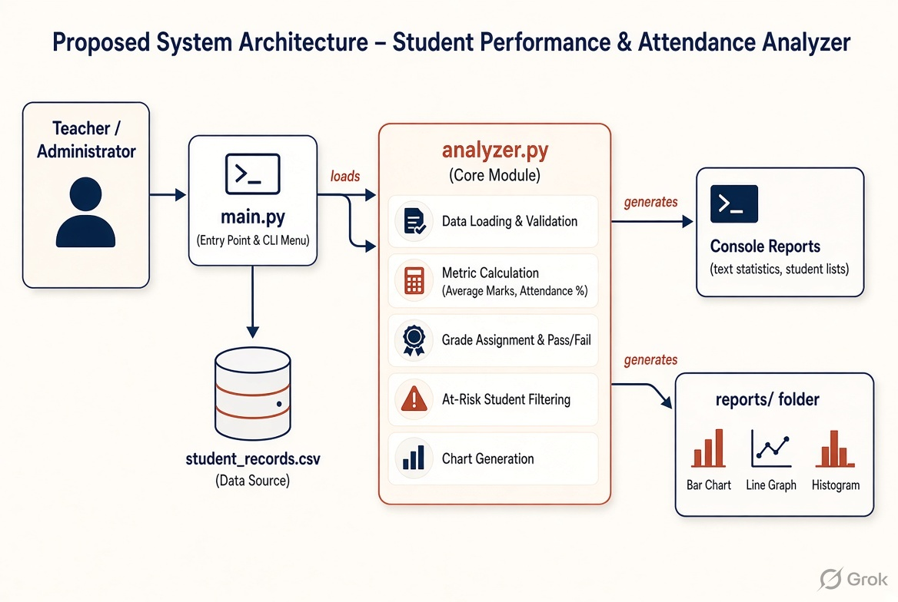
CHAPTER 6
Proposed System Architecture
CSV Data Input
Pandas Processing
Matplotlib Engine
CLI & Reports
students.csv
Metrics & Grades
Chart Export
Console & PNGs

Slide 8



CHAPTER 7
Technology Stack & Tools
Python 3.x
Pandas
Matplotlib
Core object-oriented engine driving internal application logic.
High-performance data manipulation, filtering, and aggregation.
Graphical library for generating bar charts, histograms, and line graphs.

Slide 9
CHAPTER 8
Modular Code Structure
main.py
analyzer.py
student_records.csv
requirements.txt
Command-line interactive menu interface for navigating system features.
Calculates performance averages, attendance %, grade logic, and defaulter lists.
Sample dataset used for testing and demonstration.
Lists required packages (pandas, matplotlib, etc.).

Slide 10



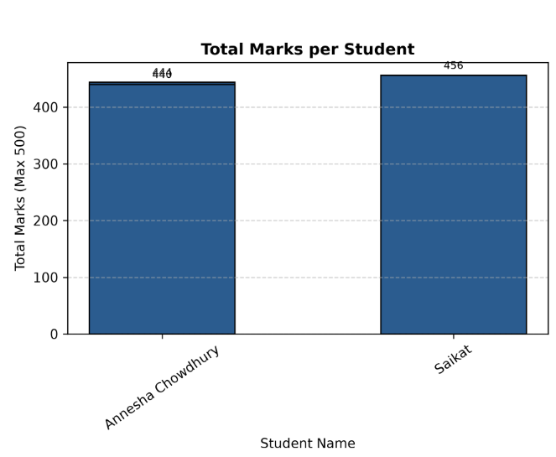
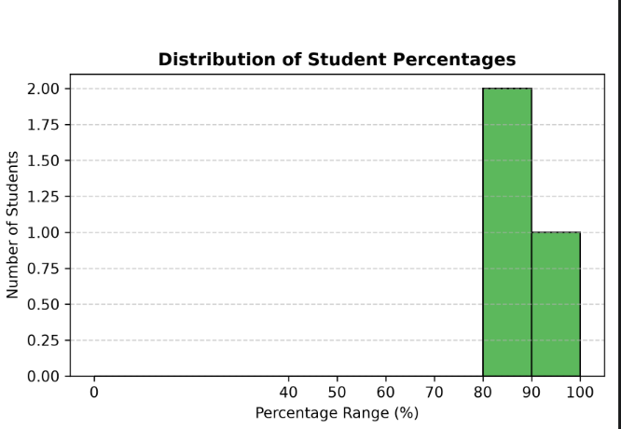
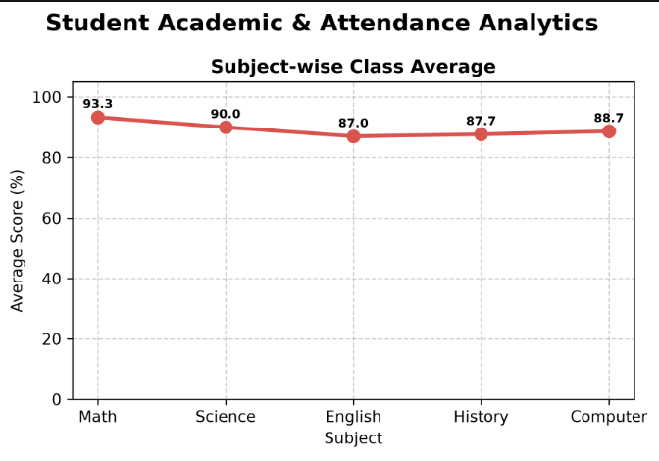
CHAPTER 9
Experimental Results & Charts
Bar Chart Output
Line Graph Output
Histogram Output
Compares total marks per student visually for leaderboard ranking.
Illustrates subject-wise class average score trends across all modules.
Displays frequency distribution of overall class percentage ranges.

Slide 11
CHAPTER 10
Project Conclusion
Automated Data Workflow
Eliminated manual calculations and spreadsheet overhead for tracking student progress.
Modular Software Architecture
Organized codebase into reusable Python modules, allowing easy maintenance and scalability.
Effective Visual Communication
Generated intuitive graphical reports enabling educators to make quick, data-driven decisions.

Slide 12
CHAPTER 11
Future Enhancements
Web & Mobile App
Automated Alerts
Real-Time Attendance
Transition CLI into interactive Streamlit / React web interfaces.
Send automated Email/SMS reports to parents of low-attendance students.
Integrate QR code or biometric tracking directly into database backend.

Slide 13
CHAPTER 12
References & Resources
1. pandas Development Team (2024). pandas: Powerful data structures for data analysis. Available at: https://pandas.pydata.org/
2. Hunter, J. D. (2007). Matplotlib: A 2D graphics environment. Computing in Science & Engineering, 9(3), 90-95.
3. McKinney, W. (2022). Python for Data Analysis (3rd ed.). O'Reilly Media.
4. Python Software Foundation (2024). Python Language Reference, version 3.x. Available at: https://www.python.org/
5. Project Source Code Repository: Hosted on OneDrive Project Directory.

Slide 14
THANK YOU

